Slide 1
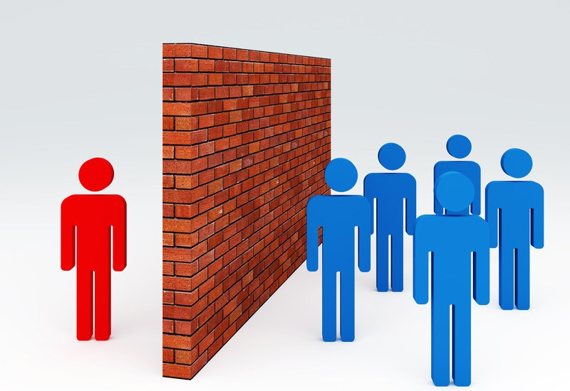
BARRIERS TO COMMUNICATION

Slide 2
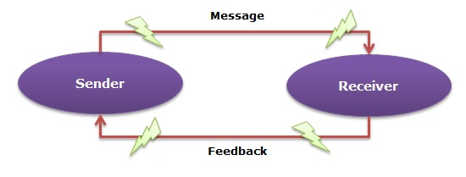
Types of barriers to communication
Psychological barrier
Linguistic barrier
Cultural barrier
Physiological barrier
Physical barrier

Slide 3
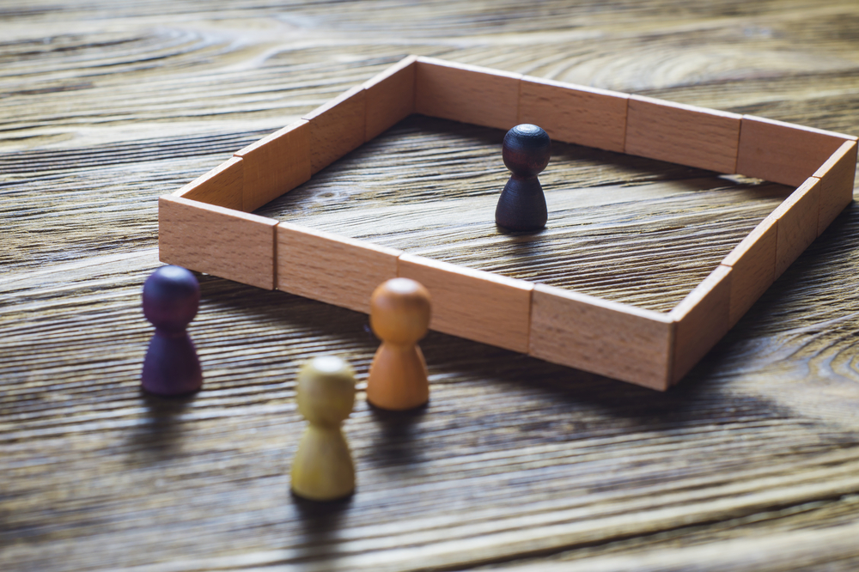

PHYSICAL BARRIER

Slide 4
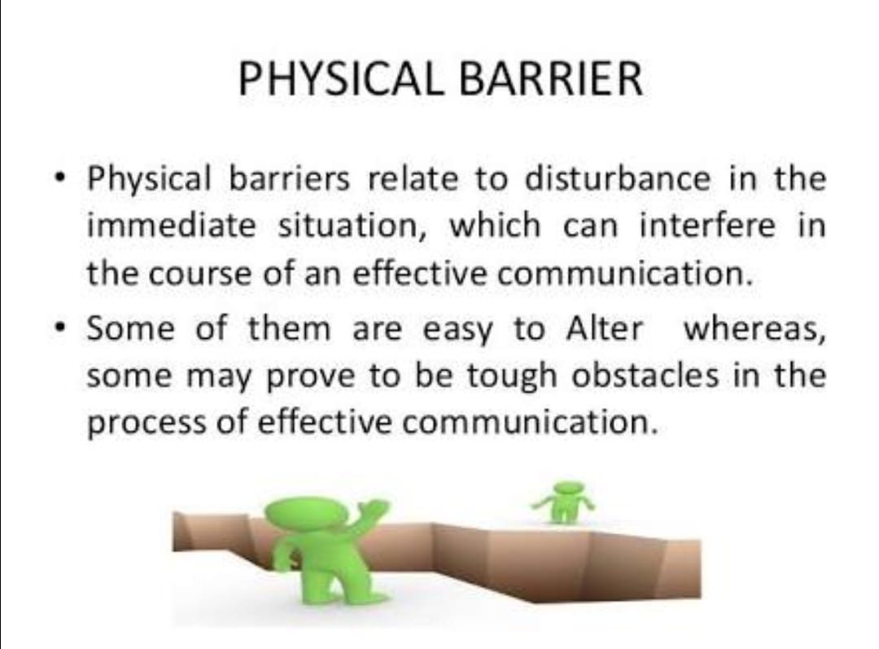

Slide 5
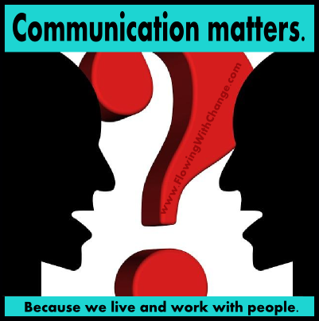
Types of physical barriers:
Time and distance
Noise
Climate
Place
Information overflow

Slide 6
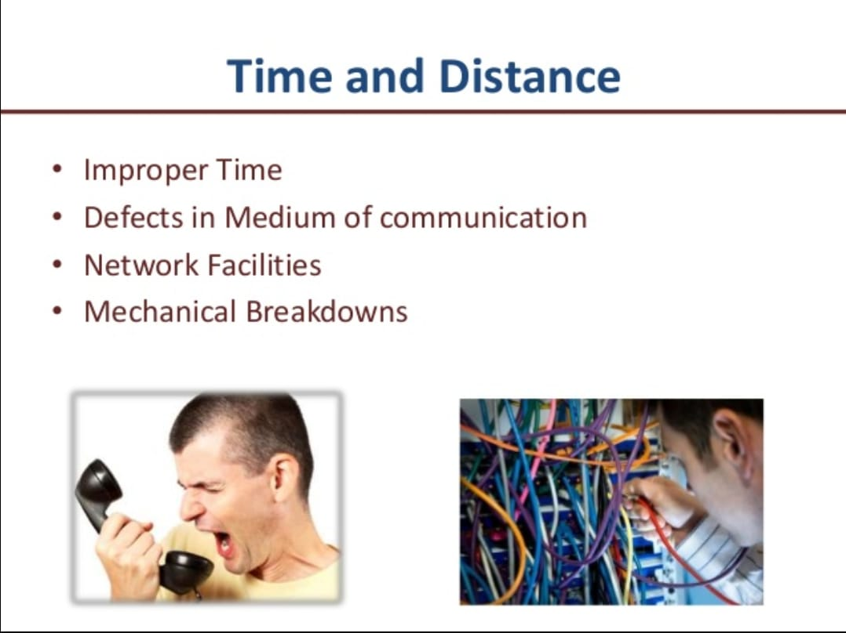
If a message is not sent in inappropriate time, the message will not have the effect that it should have, as the intention will not be met.
Quickness of communication is the watch world in modern world of communication.
Communication is generally easier over short distances as more communication channels are available and less technology is required.

Slide 7
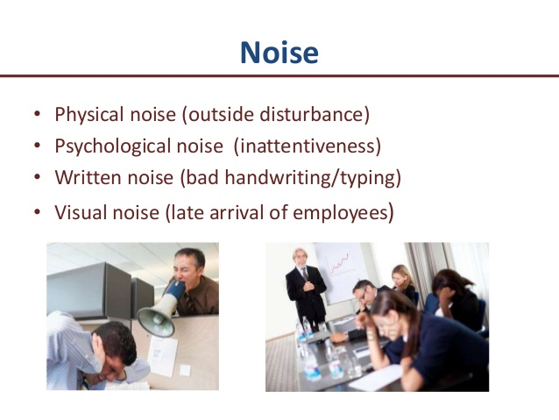

Slide 8
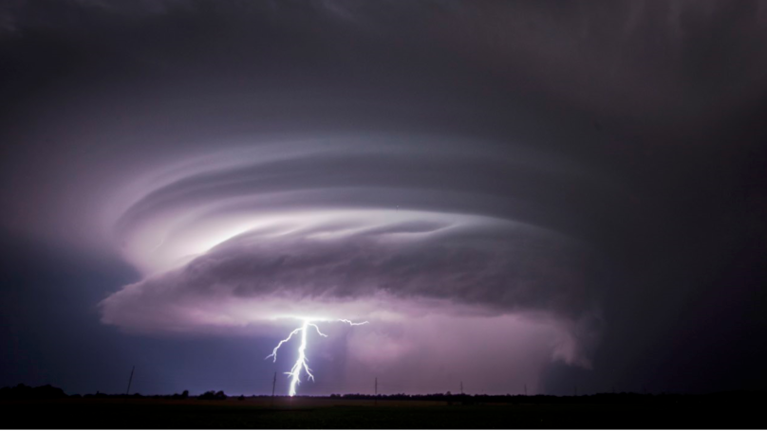

Slide 9

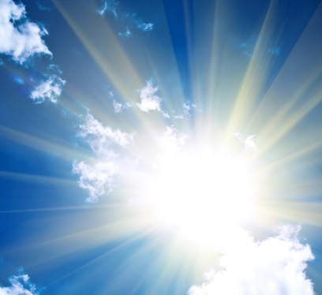
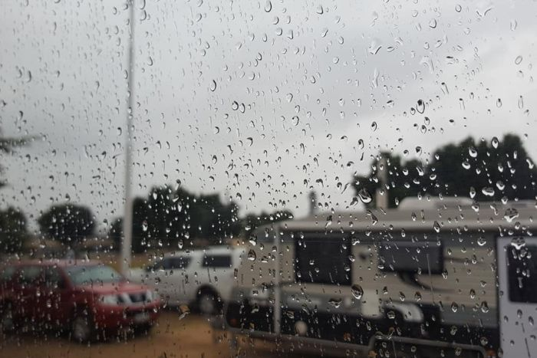
WEATHER
OR

Slide 10
Natural noise like thunder, rain, wind are present in the environment which disturbs the communication.
Unfavourable climate acts as barriers to communication leading to wrong perception or decisions.

Slide 11
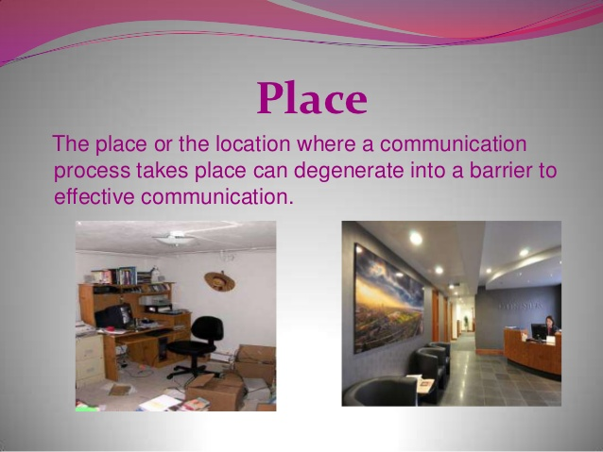

Slide 12
The place or location where the communication take’s place can degenerate into a barrier to effective communication.
Inconvenient place, poor lighting, inadequacy of space make’s people impatient and annoyed

Slide 13
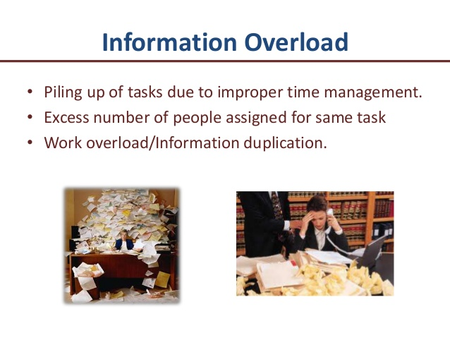
When information becomes more than that can be received at a particular time by the receiver, then communication fails.
The receiver does not have the capacity to get all the information and can miss some important points or misinterpret the meaning of the whole message altogether.

Slide 14
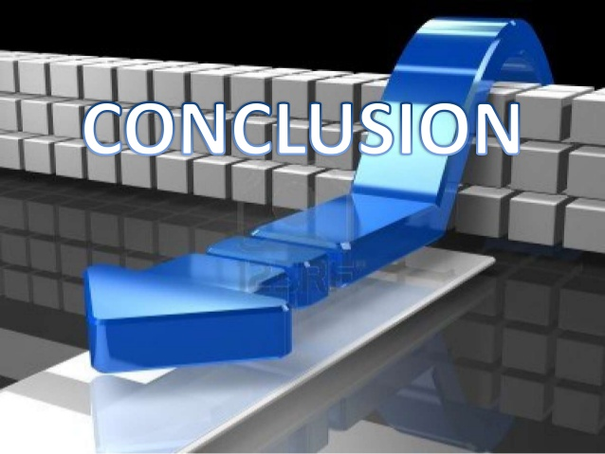

Slide 15
Ways to overcome barriers to communication:
For physical barriers:
Appropriate seating arrangement
Ensure visibility & audibility
Environmental comfort
Minimize visual / Oral distractions

Slide 16


